Slide 1


TEEGALA KRISHNA REDDY ENGINEERING COLLEGE
Department of Computer Science & Engineering
HEAD OF THE DEPARTMENT
Dr.CH.V.PHANI KRISHINA
Professor

Slide 2
ENERGY EFFICIENT TEACHING-LEARNING-BASED OPTIMIZATION FOR THE DISCRETE ROUTING PROBLEM IN WIRELESS SENSOR NETWORKS
INTERNAL GUIDE
A DIVYA SREE Assistant professor
NAME OF THE STUDENTS
18R91A0570 - B VIJAYKUMAR
20R95A05O2 - A SRI SAI CHAITANYA
20R95AO529 - V SRIHITHA REDDY

Slide 3
CONTENTS
ABSTRACT
EXISTING SYSTEM
PROPOSED SYSTEM
SYSTEM ARCHITECTURE
ALGORITHMS
FLOW CHART
UML DIAGRAMS
CONCLUSION
REFERENCES

Slide 4
ABSTRACT
Wireless sensor networks (WSNs) are composed of sensor nodes, having limited energy resources and low processing capability. Accordingly, major challenges are involved in WSNs Routing. Thus, in many use cases, routing is considered as an NP-hard optimization problem. Many routing protocols are based on metaheuristics, such as Ant Colony Optimization (ACO) and Particle Swarm Optimization (PSO). Despite the fact that metaheuristics have provided elegant solutions, they still suffer from complexity concerns and difficulty of parameter tuning. In proposed a new routing approach based on Teaching Learning Based Optimization (TLBO) which is a recent and robust method, consisting on two essential phases: Teacher and Learner. As TLBO was proposed for continuous optimization problems, this work presents the first use of TLBO for the discrete problem of WSN routing. Experimental results show allow obtaining lower energy consumption which leads to a better WSN lifetime. Our method is also compared which leads to some typical routing methods; PSO approach, advanced ACO approach, Improved Harmony Search Based Energy Efficient Routing approach(IHSBEER) and Ad-hoc On-routing demand Distance (AODV) routing protocol, to illustrate TLBO’s routing efficiency.

Slide 5
EXISTING SYSTEM
Wireless Sensor Networks (WSNs) are network systems formed by sensors able to communicate without using any specific network infrastructure.
There are various categories of sensors, depending on the environmental situation(temperature situation (temperature,humidity,pressure,etc…)
thus, WSNs are used in many applications such as diasaster agriculture,medicine and health care.
Nonetheless, there are some intrinstic limitations for the sensors like low process capacity or power
Limited lifetime

Slide 6
PROPOSED SYSTEM
Teaching-learning-based optimization :
Teaching-Learning-Based Optimization algorithm (TLBO) is a novel optimization method proposed by Rao et al. This approach has been inspired by the teacher’s influence and learners interaction. It outperforms some of the well-known metaheuristics regarding constrained benchmark functions, constrained mechanical design, and continuous nonlinear numerical optimization problems. TLBO has been applied to various problems such as the QoS multicast routing problem and optimal reactive power dispatch problem. It could be split into two basic parts: Teacher phase and Learner phase.

Slide 7
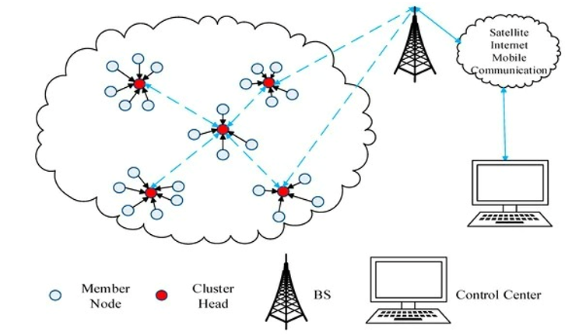
SYSTEM ARCHITECTURE

Slide 8
ALGORITHMS
Teaching-learning-based optimization :
Teaching-Learning-Based Optimization algorithm (TLBO) is a novel optimization method proposed by Rao et al. This approach has been inspired by the teacher’s influence and learners interaction. It outperforms some of the well-known metaheuristics regarding constrained benchmark functions, constrained mechanical design, and continuous nonlinear numerical optimization problems. TLBO has been applied to various problems such as the QoS multicast routing problem and optimal reactive power dispatch problem. It could be split into two basic parts: Teacher phase and Learner phase. Figure 3 describes the TLBO process.

Slide 9
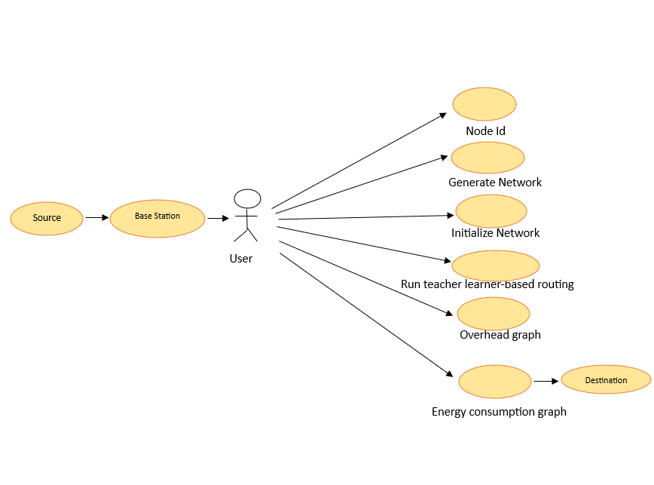
UML DIAGRAMS
USE CASE DIAGRAM:

Slide 10
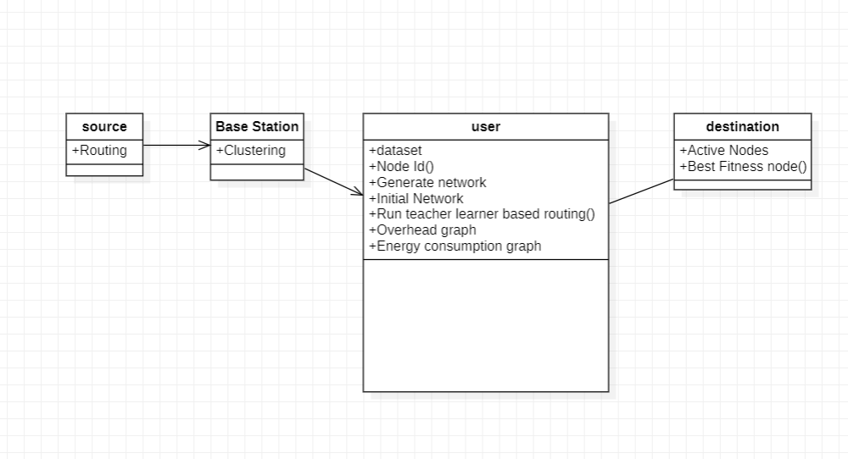
CLASS DIAGARM

Slide 11
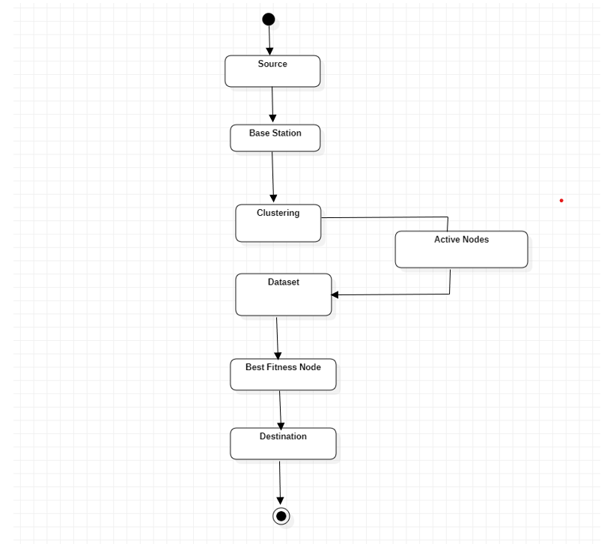
ACTIVITY DIAGRAM

Slide 12
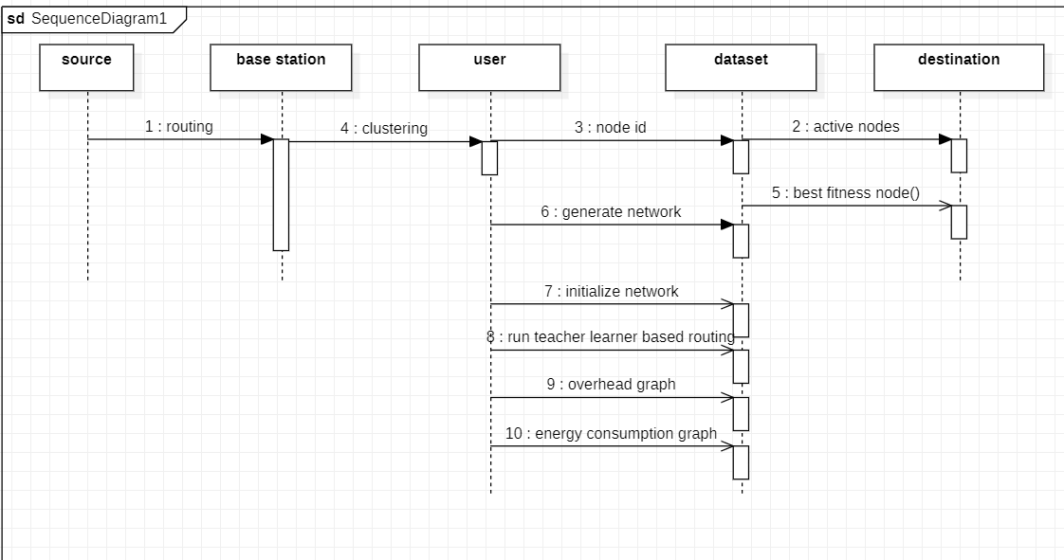
SEQUENCE DIAGARM

Slide 13
CONCLUSION
Routing in WSN has introduced many challenges compared to traditional data routing in wired networks. This project presents a new routing protocol using a novel optimization method based on the philosophy of the teaching-learning process combined with the edge recombination operator. That TLBO approach ensures a robust optimization of the energy consumption, thus increases network lifetime as validated by simulation results. By performing experimentation in the same simulation conditions, TLBOR protocol is compared to some routing protocol in WSNs such as: ACO, PSO and IHSBEER approaches and AODV protocol. Then overall the results show that our TLBOR protocol is better in terms of energy consumption and network lifetime. As a future work, it is planned to improve our routing approach by incorporating other quality of service (QoS) metrics and performing the experimentation in real WSN. Additionally, the improved approach will be applied to mobile nodes and networks with multiple sinks.

Slide 14
REFERENCES
Potdar V, Sharif A, Chang E (2009) Wireless sensor networks: A survey. In: International Conference on Advanced Information Networking and Applications Workshops. WAINA’09., IEEE, pp 636–641
2. Akyildiz IF, Su W, Sankarasubramaniam Y, Cayirci E (2002) Wireless sensor networks: a survey. Comput Netw 38(4):393–422
3. Xu N (2002) A survey of sensor network applications. IEEE Commun Mag 40:102–114

